Slide 1
‘Te whenua, te tangata, te ao āmua’
Wellington tangata whenua aspirations for placemaking
Notes:
Pepeha
Mihi – kaumatua
Thanks to Council,
Thanks to RUF
Acknowledge Wgtn Tenths and Uncle Ralph
Wellington case study
Shows huge variation of experience
May be common themes (ref Blair in TTO)
Why using term ‘iwi kainga’
Point out the pā – which aren’t visible
Harbour long history – going back to taniwha, Kupe and Ngai Tara
Relative newcomers – area had had few permanent settlements, most lived up the coast
1830’s kainga round harbour – ahi kaa, building Te Aro pa and others
Multi iwi – hapū

Slide 2
“Indigenous people have always demonstrated the capacity to generate a collective sense of purpose and plan for the future.”
Sue Jackson

Slide 3
Visions
Port Nicholson Block Settlement Trust
Ki te whakahou, whakapakari me te whakanikoniko i te ahurea, papori, rangatiratanga o Taranaki Whānui ki Te Upoko o Te Ika
To restore, revitalise, strengthen and enhance the cultural, social and economic well-being of Taranaki Whānui ki Te Upoko o Te Ika
Wellington Tenths Trust
… incorporating cultural, social, spiritual and financial considerations in their decision making

Slide 4
Tangata whenua aspirations for Wellington city
Unearthing the layers
Becoming visible
Growing the footprint

Slide 5
Treaty settlements
Notes:
Social and economic and social hub (still is but in different way) – where trading took place, meeting place, food sources
Slide shows cities being built around and on top of our settlements
Loss of fishing, cultivations, trade base – economic
Land deprivation to 5% of land area – probably less in urban areas

Slide 6
“Settler histories often write over the histories of indigenous peoples, at once invalidating and rendering invisible their own cultural, political, economic and social landscapes.”
Tracey McIntosh

Slide 7
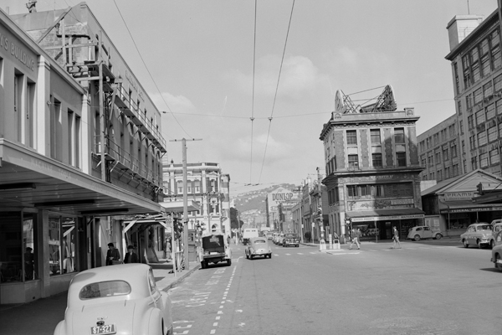
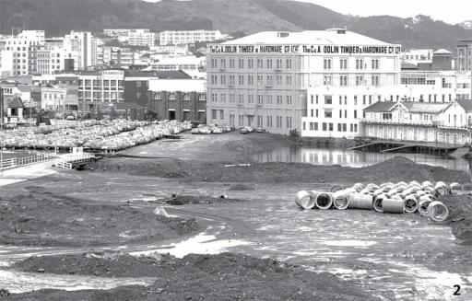
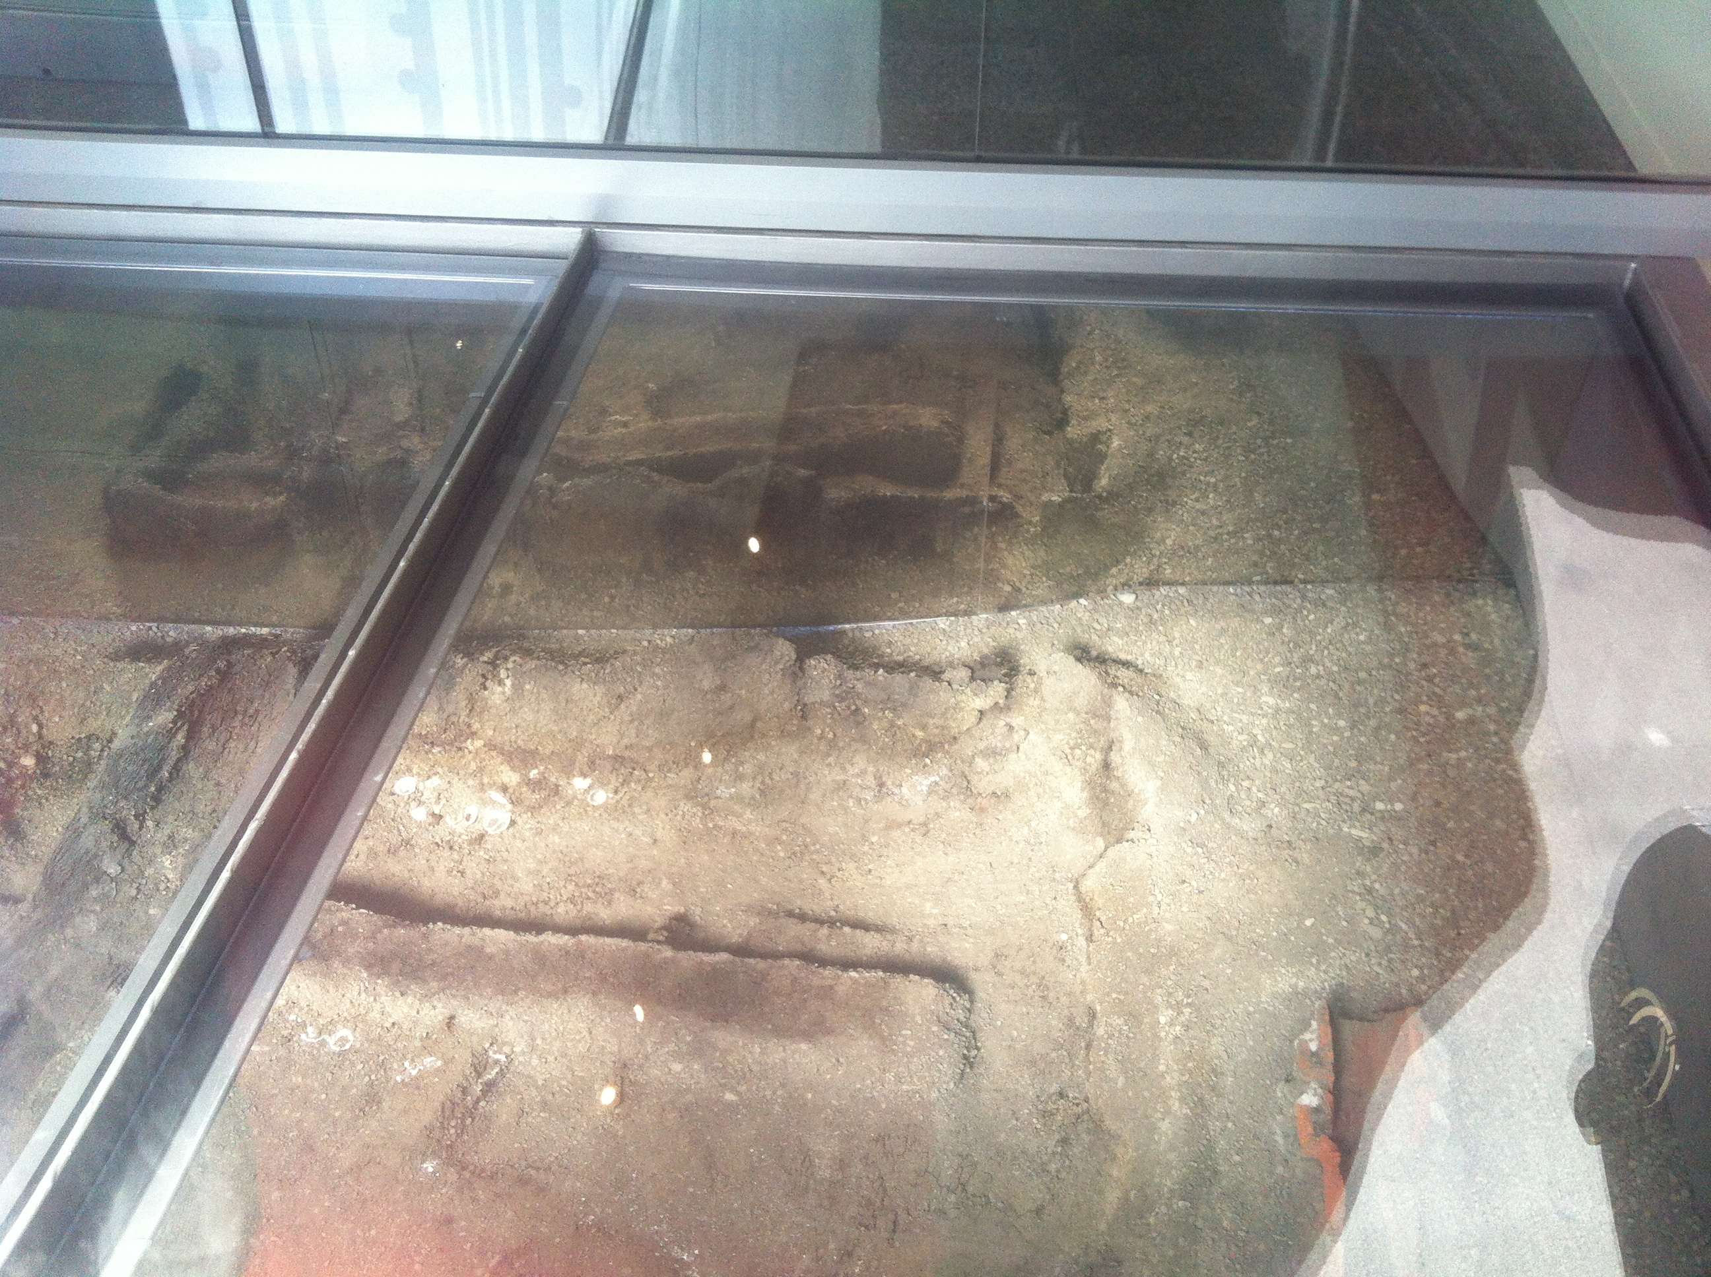
“Unearthing the layers”

Slide 8
Unearthing the layers
Putting the long Māori heritage of the city into the plans
Telling the stories to everyone
Looking at neighbourhoods - what are the Māori histories of Kelburn, Northland, Island Bay?
Notes:
November 2005 when the remains of Te Aro Pā, occupied between the 1820s and 1880s, were uncovered.
Built by Ngāti Mutunga c1839
Then settled by Taranaki, Ngāti Ruanui, Te Atiawa – 300+ inhabitants in 1840
Pā also included mahinga kai, gardens, Waitangi swampland, forests
Centre of trading in flax, wood, food
The New Zealand Historic Places Trust, developer Washington Ltd, the City Council and the Wellington Tenths Trust – which administers Māori land around the city – then considered options for preserving the structures.

Slide 9
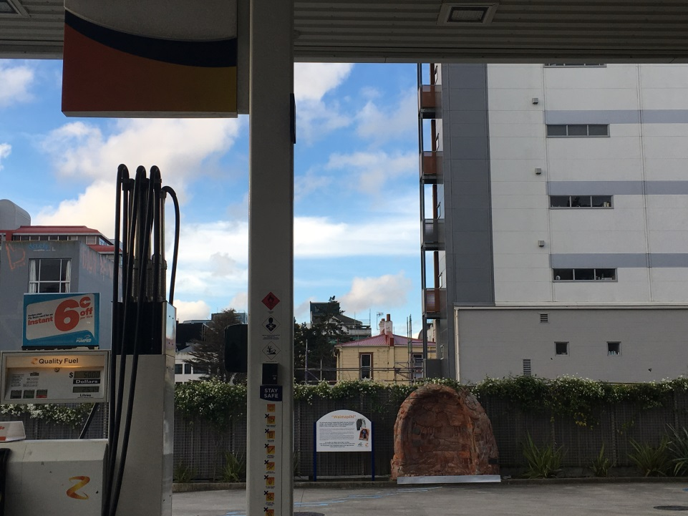
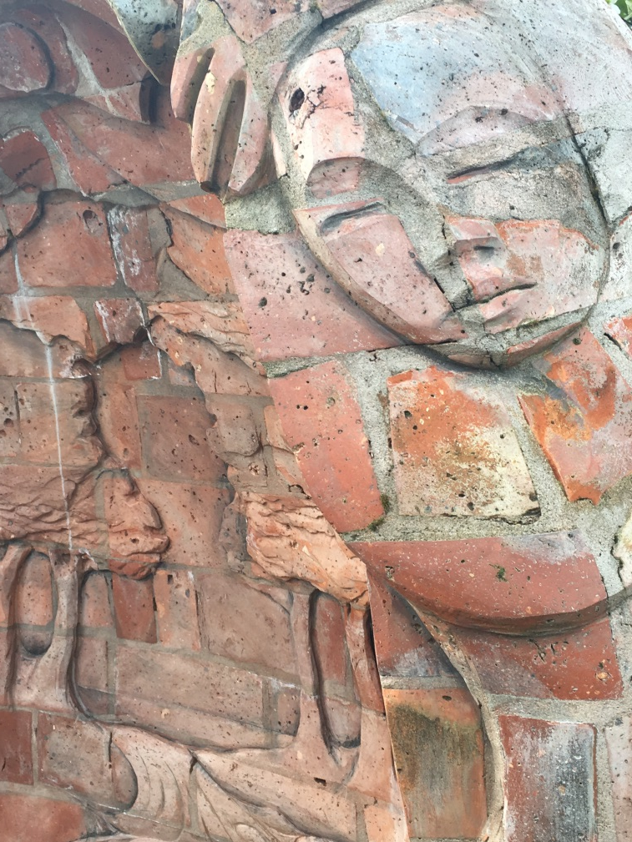
“Becoming visible”

Slide 10
Becoming visible
Low visibility – as tangata whenua with a role and place in Wellington
Visibility should be real, concrete, public – tangata whenua are not seen only on special occasions
Berg - “Everyday visibility”
Māori community participation in planning – wānanga, co-design design sprints

Slide 11
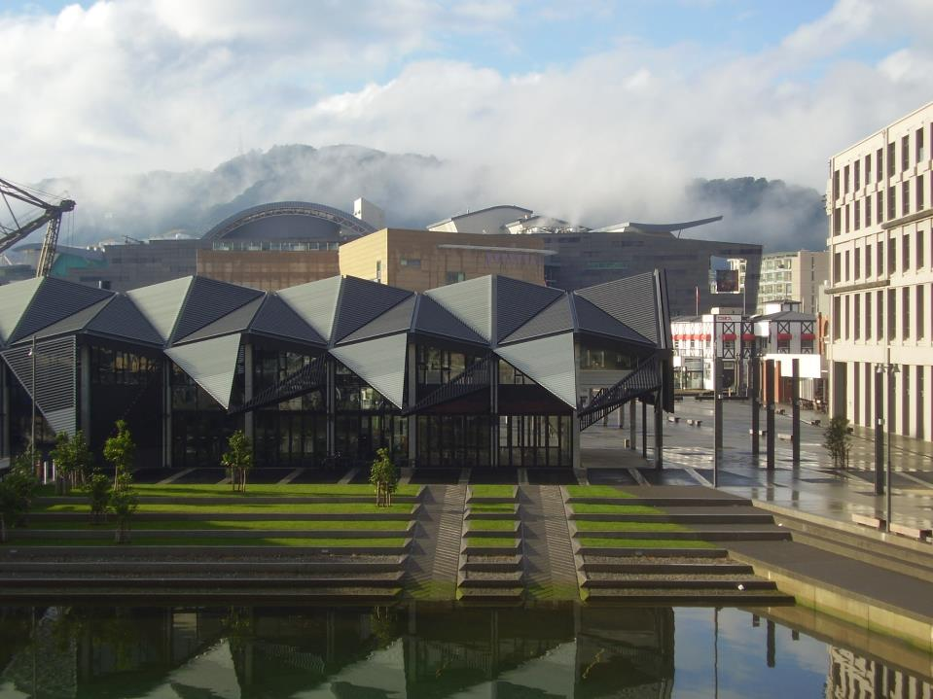
“Growing the footprint”

Slide 12
Growing the footprint
Planning: must integrate spiritual, social and economic development
Housing “to bring Māori back into the city”
Visibly Māori-owned businesses
Stronger WCC support for the development of Māori organisations, such as skill-building
Places to access whakapapa and iwi history, to hui, wānanga and plan community building
2015 Wellington Urban Growth Implementation Plan contained no reference to Māori

Slide 13
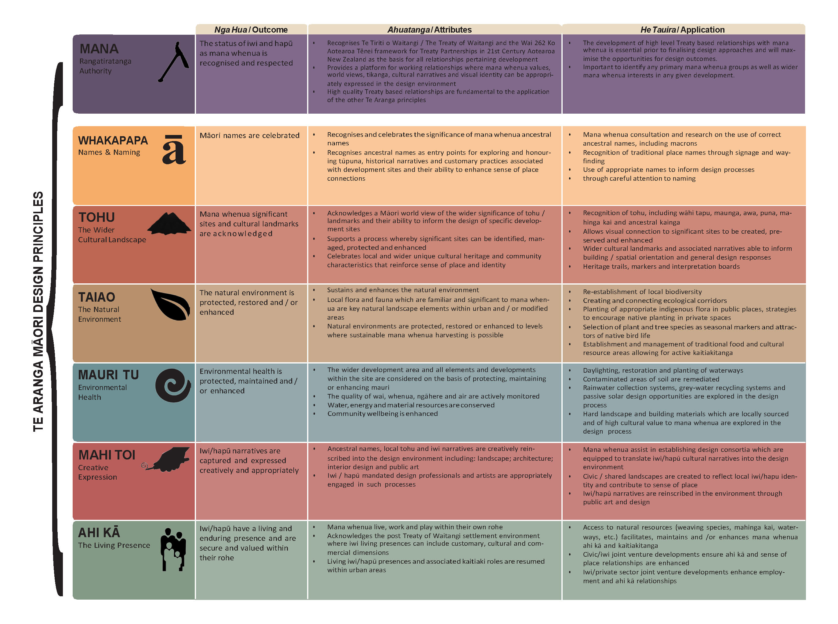

Slide 14
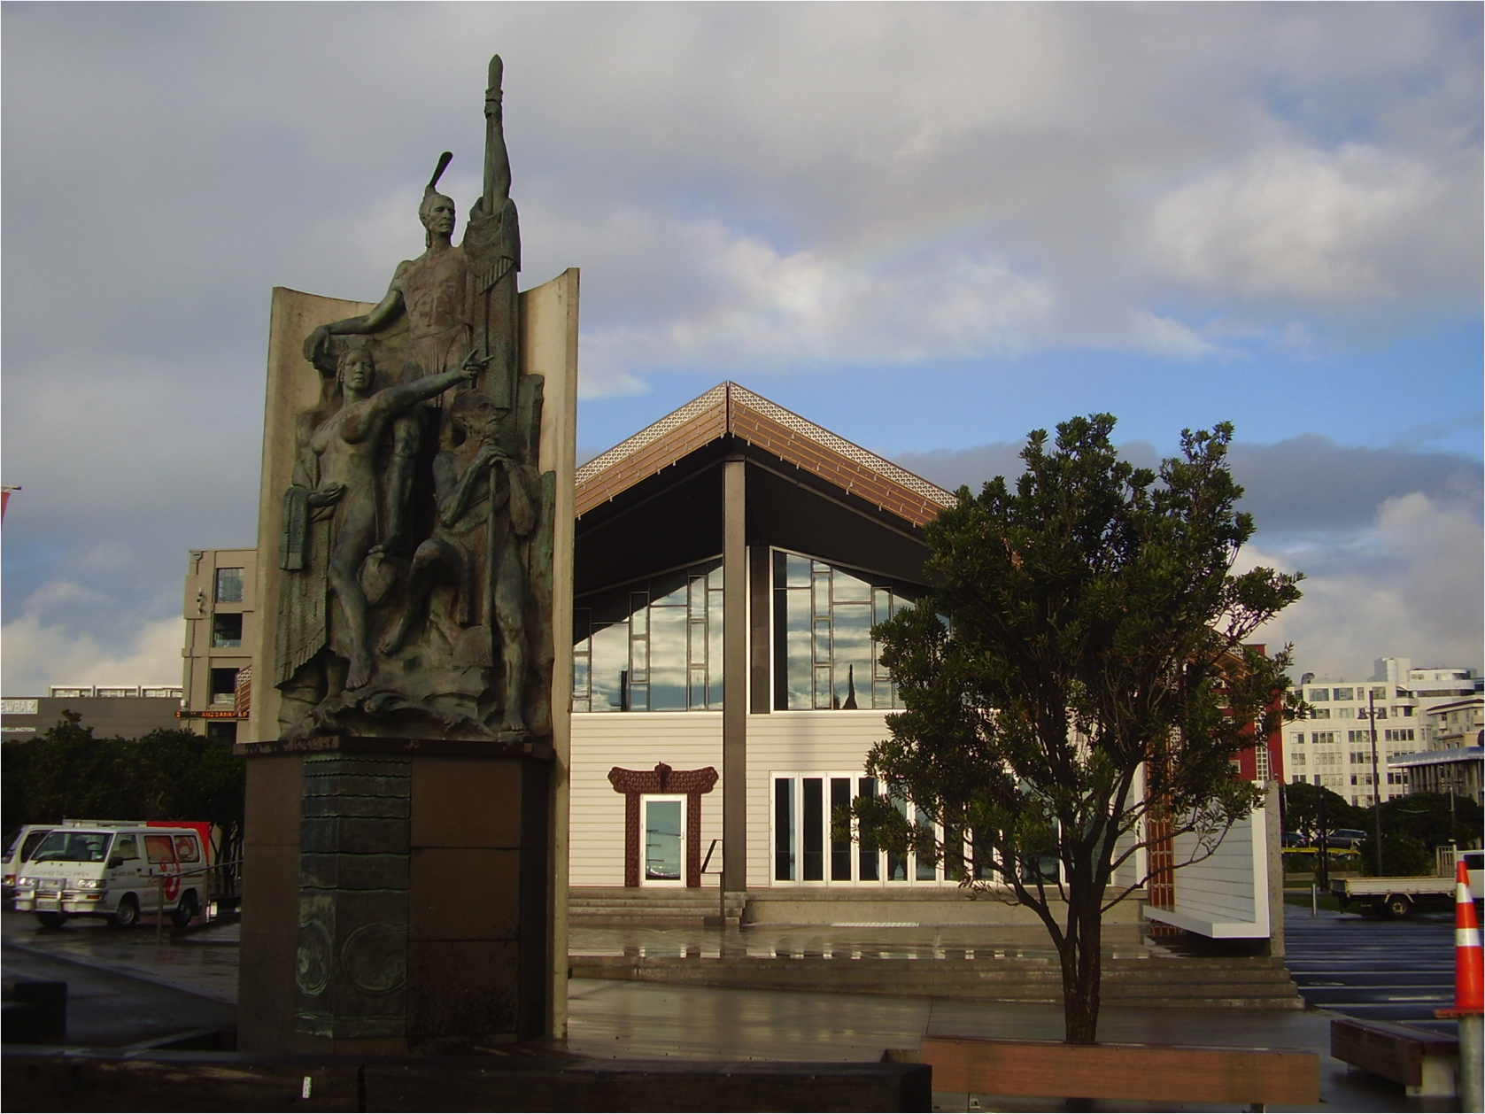
Kupe and whānau
- a purposeful journey

Slide 15
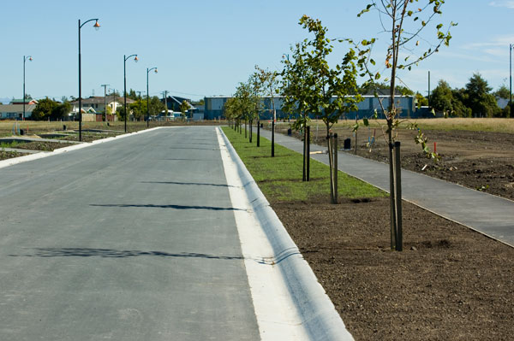
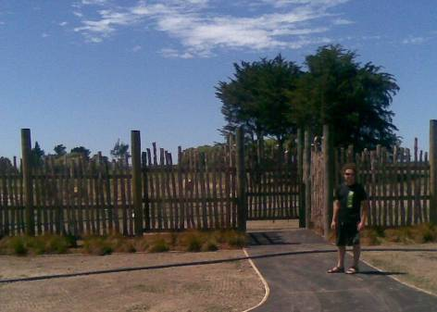
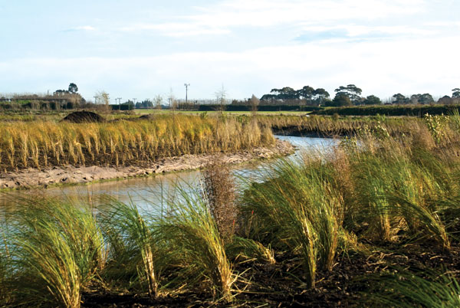
Kaitiakitanga o ngā Ngahere Pōhatu
Māori values for urban planning
Dr Shaun Awatere (Ngāti Porou)
Manaaki Whenua Landcare Research

Slide 16
Ngā Kaupapa IDEOLOGIES
Whakamahere
Te Ao Māori
Te Ao Pākeha
Dual Approach
Empowers Māori Position

Slide 17
He Anga FRAMEWORK
Mana Whakahaere TREATY BASED APPROACH
Ngā Pou Herenga
CORE PRINCIPLES
Ngā Huānga
OUTCOMES
Ngā Uaratanga
GOALS AND OBJECTIVES
Ngā Arotakenga
EVALUATION and MONITORING
Ngā Kaupapa
RULES, POLICIES and METHODS
Ngā Mahinga
APPLIED ACTIONS

Slide 18
Ngā Inenga MEASURES
Holistic
Qualitative and Quantitative
Te Taha Kiko
Whakapapa
Te Taha Wairua
Te Taha Whānau
Arotake

Slide 19
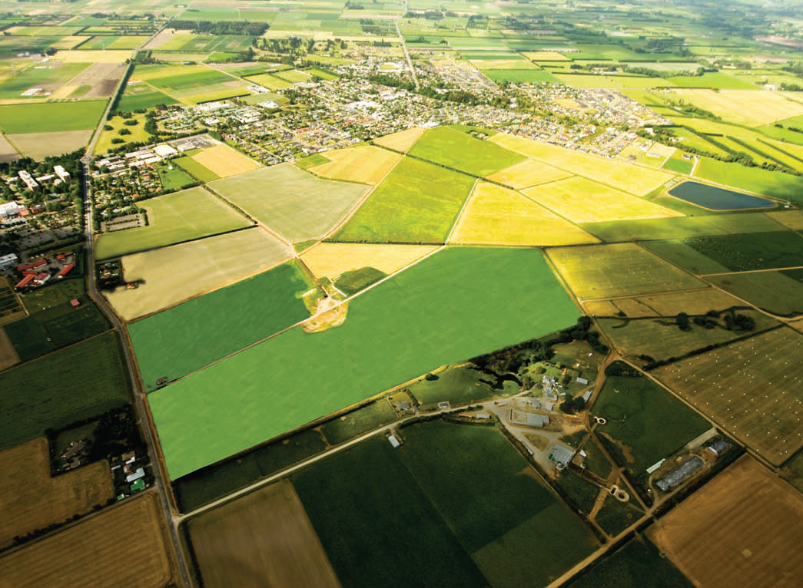
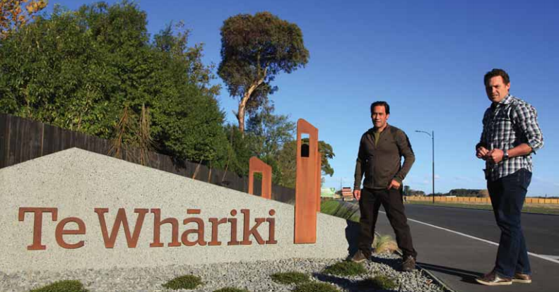
Image source: ngai tahu property
Image source: ngai tahu property
Notes:
The Lincoln Land Developments subdivision is a large-scale (~120 ha) residential and commercial development at Lincoln, near Christchurch on the former Lincoln University Dairy Farm Block. The development aims to connect the existing Lincoln Township with Lincoln University and will provide mixed density housing, community, civic, retail and educational space, green/recreational areas, and integrated stormwater management (NTP 2009).
“LLD is aiming for an outcome that has the best environmental benefits practicable and wants this development to be a local benchmark for sustainable development and stormwater management in a new residential environment” (Golder 2009 p1).
The development is a long term exercise being planned in stages with Stage 1 being available for sale in late 2010 and the final Stage (4) being complete in 2020. Resource consent for Stage 1 was submitted in March 2009 and includes consent for 92 sections with a minimal allotment of 650 m2, 5 roading allotments, 10 reserve allotments and 1 utility allotment (RMG 2009).
The development features the creation of a significant stormwater system that will re-naturalise the ‘Lincoln Main Drain’ which feeds into spring creek and the Ararira/LII River, a traditionally significant tributary of Te Waihora/Lake Ellesmere, a tribal taonga of Ngāi Tahu. Other important sites downstream of the development include Makonui/Claybar Lagoon and Tarerekautuku/Yarrs Lagoon, both traditional mahinga kai sites (Taiaroa 1880).

Slide 20
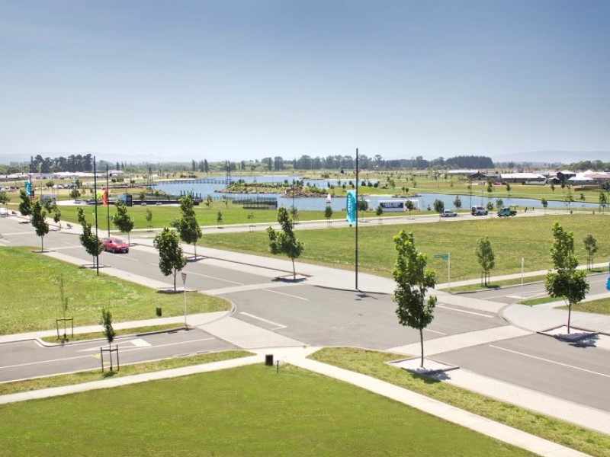
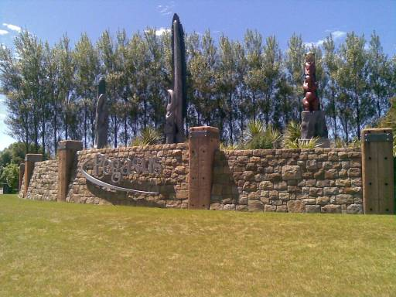
image source: todd property
Pegasus
Notes:
Pegasus is a major new town development to the north of Christchurch which plans to be the home for up to 7,000 residents and will house large recreational, entertainment and commercial facilities including “restaurants and cafes, boutique shopping and larger-scale retail stores, a premier resort hotel, dedicated yacht club, swimming bay, hot pools and aquatic centre, a golf club and community course - all within walking distance of every home”.
As its website suggests, the development is “built around a beautifully designed lake and extending to the shores of Pegasus Bay...[and is] set at the heart of a remarkable coastal eco-system. Pegasus has been designed to protect and enhance the conservation and cultural values of its surrounding environment. Pegasus is also established as a vibrant, sustainable community – with opportunities for work, education and leisure developed at the very beginning of the project. Pegasus has been conceived for the traditional Kiwi family – to create the ideal place to live, where you play”.
Importantly for manawhenua, the development flanks one of the most significant of all sites to the local people, Kaiapoi Pā as well as the associated Taerutu Lagoon. The history of the pā is well known and therefore offered a significant challenge in terms of appropriately recognising and providing for wāhi tapu, mahinga kai and other important cultural values.

Slide 21
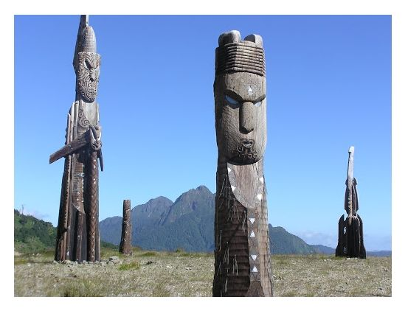
Ngā huanga Matua
Key Findings
Image Source:www.ngatiporou.com

Slide 22
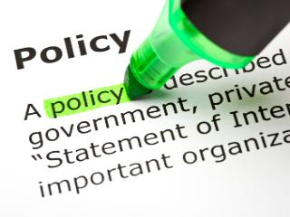
Informed Policy
Image Source:www.policies.uci.edu
Notes:
Kaupapa Māori informed Policy
The case studies identified an abundance of useful policy and strategies that have successfully incorporated Māori ethical positions. For example, Whakatōhea have developed a draft Iwi Economic Development Strategy that is based on kaupapa Māori values: rangatiratanga (acting with dignity and humility, taking ownership, expecting excellence), whanaungatanga (relationship building), matawhānui (broader perspective), manaaki ki te tangata (people matter), and kaitiakitanga (guardianship). In the Ngāti Awa and Ngāti Tūwharetoa cases, excellent strategies have been developed that are underpinned by kaupapa Māori values, including kaitiakitanga, manaakitanga, whakapapa and iwitanga. In all cases, values alignment is an expectation for the institutions involved in economic decision-making. A significant challenge for all case studies is the ability to effectively implement kaupapa Māori-based decision-making.

Slide 23
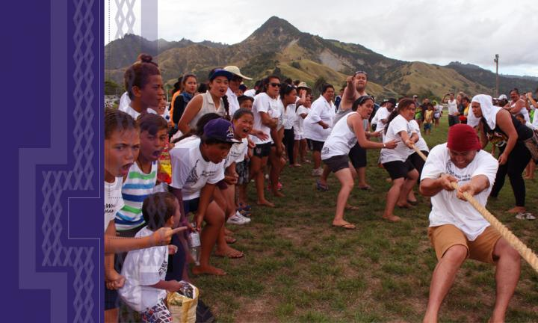
Connectedness
Image Source:www.ngatiporou.com
Notes:
Connectedness with Whānau
The drive for greater engagement between asset holding companies and tribal members is usually borne from situations where tribal members are affected by commercial development. To mitigate the disconnect between asset holdings companies and local tribal people, Ngāi Tahu Holdings have been implementing Local tribal advisory groups. These groups are effective when collective asset-managers work directly with hapū and whānau through resourcing a mandated group of representatives to provide key guidance from a kaupapa Māori perspective on a commercial development. AGs have largely arisen out of RMA processes and tend to focus on resource consent issues for a property development including: stormwater management, landscape design, street naming, and branding. A significant benefit of AGs is the development of productive working relationships between mana whenua and collective asset-managers, which can lead to an improvement in more kaupapa Māori-matched outcomes. We think that mechanisms such as AGs ought to be employed more by collective asset-managers more often across a range of investment decisions.

Slide 24
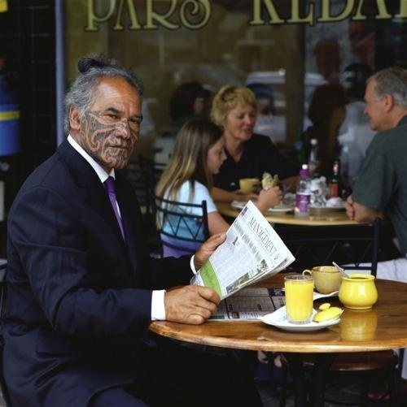
Advocates
Image Source:www.thezoom.com
Notes:
Kaupapa Māori Advocates
The efficacy of a Māori value-set in business is predicated on Māori being able to make decisions that directly affect the manner in which their assets are managed. This necessitates active Māori management of Māori collective assets and enterprises. Concomitant with active management is a capacity building effort to produce skilled, and willing candidates to take on managerial and operational roles of collective assets. For the Ngāi Tahu case study, there are currently gaps on the part of some staff with regard to understanding and applying Ngāi Tahu kaupapa Māori-based values into investment decisions. Likewise, for Ngāti Awa and Ngāti Tūwharetoa, the devolvement of managerial responsibilities to corporate entities with little understanding of kaupapa Māori values has meant a disconnection between governance groups and the collective asset-managers.
Whakatōhea have recognised the cultural mismatch and are working towards developing the essential capability for understanding Whakatōhea values in the context of investments. For example, Current processes for evaluating investment decisions require the CEO of Whakatōhea Māori Trust Board to assess opportunities based on kaupapa Māori outcomes. The challenges of effectively incorporating kaupapa Māori values into collective asset-decisions can be mitigated through capability development programmes like workshops/wānanga and/or leadership programmes. At the same time, greater utilisation of local tribal advisory groups for specific investments provide direct engagement with local tribal members along with more effective integration of kaupapa Māori values. There are some caveats with these types of arrangements including: developing and maintaining relationships based on mutual respect, longer timeframes, adequate resourcing and the capability building of all parties involved.

Slide 25
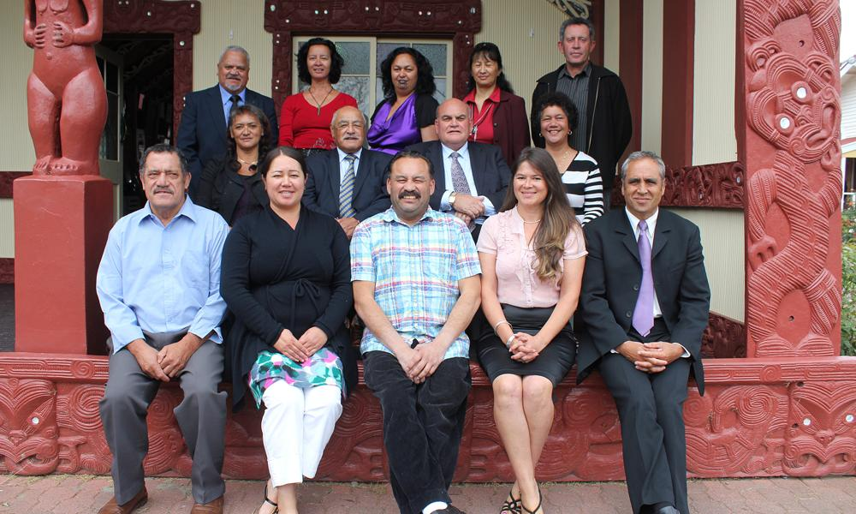
Leadership
Image Source:www.ngatiporou.com
Notes:
Kaupapa Māroi based leadership
Most collective asset-entities have been successful at developing strategy and policy informed by kaupapa Māori values. However the diversity of policies and their sheer number may potentially dilute a primary message. As a result there can be a lack of clear unifying strategy across all entities, leading to reactive governance and a lack of accountability to beneficiaries. Furthermore, the legitimacy of these strategies and policies can be challenged by asset-managers leading to a default position of profit motivations driving the direction of asset-holding companies.
In response to the over-whelming desire to pursue greater profits, some participants in the case studies have responded in a more culturally nuanced way. They believe more visionary leaders who ought to bring strong kaupapa Māori skills and experience to decision-making and are able to re-align asset holding companies towards a path more consistent with kaupapa Māori aspirations are required. The case studies also identified significant tensions for collective asset-managers in balancing economic and kaupapa Māori-based aspirations. Examples were provided where decision-makers of collective assets were forced to face “commercial realities.” In some cases, there was a sense that an investment opportunity that derived significant kaupapa Māori value could only be viable if the economic return was positive. Furthermore, there is the startling realisation that some PGSEs outsource expertise to derive short-term profit that adversely impacts on the capability of whānau to participate in managing collective assets. The handing over of management responsibilities to non-tribal members seems to be a matter of prudence and pragmatism because the current capacity for self-management is absent or nascent. In the first place, the absence of kaupapa Māori-attuned policy and advocates could lead to adverse outcomes for whānau of collectively owned assets managed by PGSEs.

Slide 26
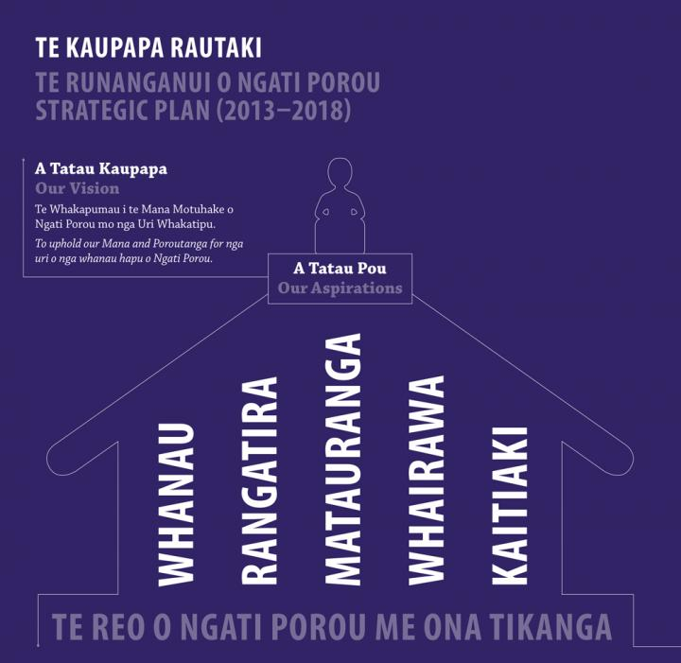
Embedding
Image Source:www.ngatiporou.com
Notes:
Embedding Kaupapa Māori
Ad hoc utilisation of local tribal advisory groups has proved beneficial in some commercial developments carried out by NTHC, but there is no formal policy or requirement for NTHC to use them. In all case studies assessment of opportunities is generally outsourced to consultants. In the absence of formal processes for aligning collective asset-management with kaupapa Māori values, there is a risk that investment decisions become profit focused while kaupapa Māori considerations become marginalised. However, there are significant opportunities for managers of collective assets to benefit from developing formal processes like SOPs attuned to kaupapa Māori values. For example, the formation of AGs for significant investments like property developments provides connectedness to whānau and substantial kaupapa Māori expertise.
The Whakatōhea case demonstrated that kaupapa Māori expertise is prevalent among the governance group and senior management. Furthermore, a kaupapa Māori approach to managing collective assets is promoted among the organisational culture along with formal processes for assessing investments. The strategic planning documents outline the core values that need to be understood and role-modelled by the Board, especially by the Chair. Kaupapa Māori values are shared and operationalised in a more direct way through senior management. A sound organisational structure and administrative support empower employees to make progress towards outcomes that are founded on a sound understanding of kaupapa Māori values. These types of processes ensure kaupapa Māori-attuned policy are successfully implemented.

Slide 27
KM Evaluation
Aue
Pōhara
Āhua Pai
Pai
Pai Rawa
Notes:
Kaupapa Māori evaluation
Monitoring and evaluation is one of the most important steps in the process of incorporating kaupapa Māori values into economic decision-making on collective assets. The case studies identified that due diligence is increasingly outsourced and some senior managers require capability building to understand the relevance of kaupapa Māori values for managing collective assets. Furthermore, there are few tools that can assist decision-makers assess investments based on kaupapa Māori values. Some Ngāi Tahu staff are tasked with monitoring and reporting on commercial investment decisions and the alignment of tribal values and policy. In practice, this process involves focusing primarily on financial measures with limited assessment from a kaupapa Māori perspective. The governance group of the Whakatōhea Māori Trust Board acknowledge that they are accountable to whānau and that their decisions must create value financially and create kaupapa Māori-attuned outcomes. The measures used to evaluate the performance of specific investments and the balance of the portfolio as a whole must reflect the values and aspirations of whānau. This project provided the Whakatōhea Maori Trust Board and the Whakatōhea Fisheries Trust with an opportunity to consider in more depth the ways they can assess the potential value of investments and ensure consistency with kaupapa Māori values. A tikanga Māori decision framework was adapted from Awatere (2014) and proposed for the evaluation of investment opportunities for Whakatōhea (Whakatōhea Investment Framework). Unique to this framework is the integration of kaupapa Māori concepts within a Māori collective asset-management paradigm. Importantly, context-specific evaluation criteria were developed with governance group members and senior managers.

Slide 28
Ngā Patai?

